Slide 1
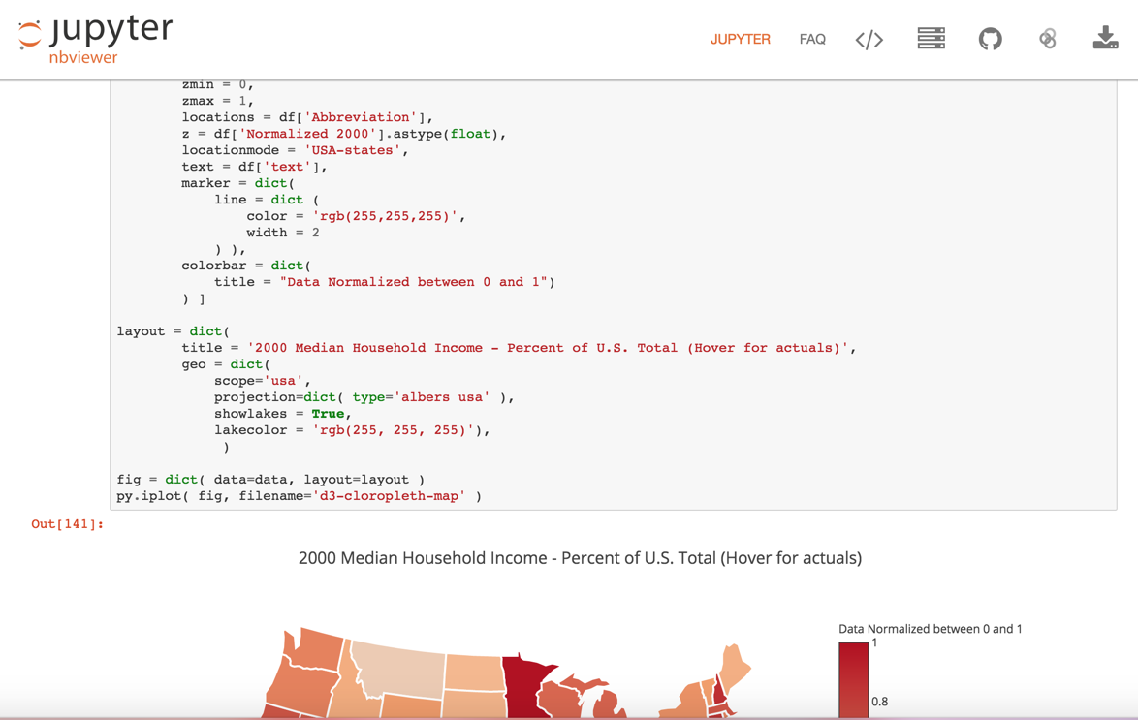
View Jupyter Notebook on Jupyter nbviewer

Slide 2
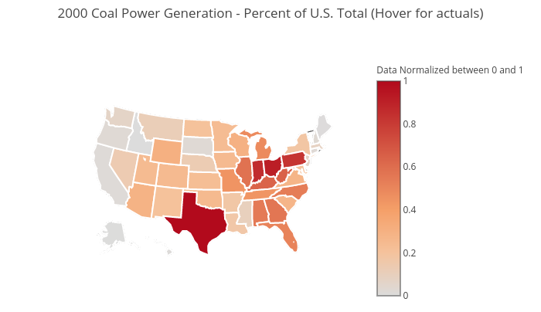
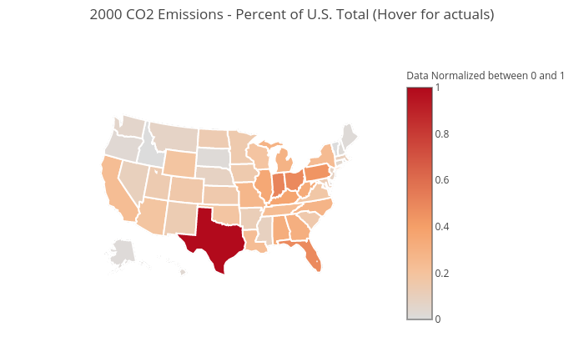
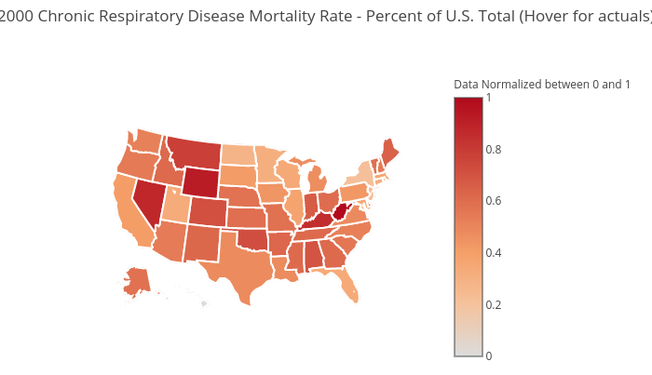
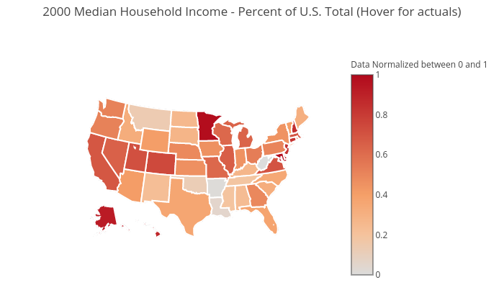
Click map to view actuals

Slide 3
Coal Power Generation vs CO2 Emissions Year 2000
Coal Power Generation
CO2 Emissions
Click map to view actuals

Slide 4
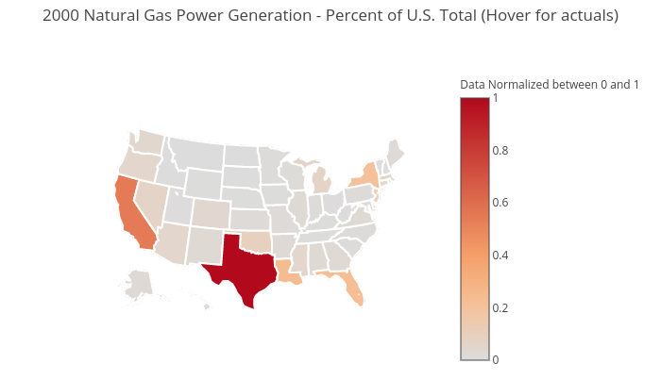
Natural Gas Power Generation vs CO2 Emissions Year 2000
Natural Gas Power Generation
CO2 Emissions
Click map to view actuals

Slide 5
Chronic Respiratory Disease Mortality Rate vs CO2 Emissions Year 2000
Chronic Respiratory Disease Mortality Rate
CO2 Emissions
Click map to view actuals

Slide 6
Chronic Respiratory Disease Mortality Rate vs Median Household Income Year 2000
Chronic Respiratory Disease Mortality Rate
Median Household Income
Click map to view actuals

Slide 7
Coal Power Generation vs Median Household Income Year 2000
Coal Power Generation
Median Household Income
Click map to view actuals

Slide 8
Natural Gas Power Generation vs Median Household Income Year 2000
Natural Gas Power Generation
Median Household Income
Click map to view actuals

Slide 9
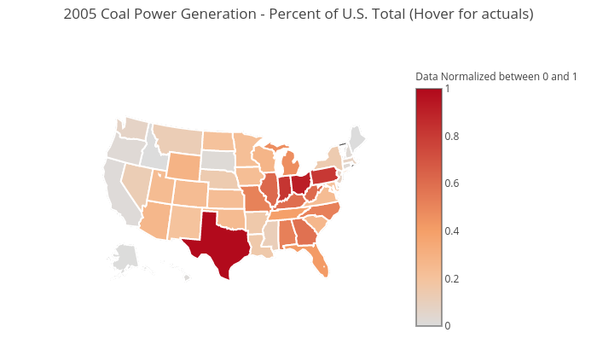
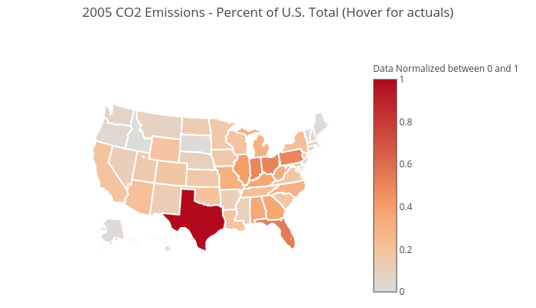

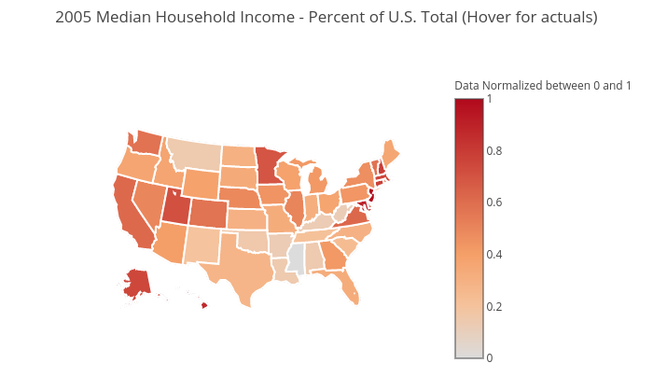
Click map to view actuals

Slide 10
Coal Power Generation vs CO2 Emissions Year 2005
Coal Power Generation
CO2 Emissions
Click map to view actuals

Slide 11
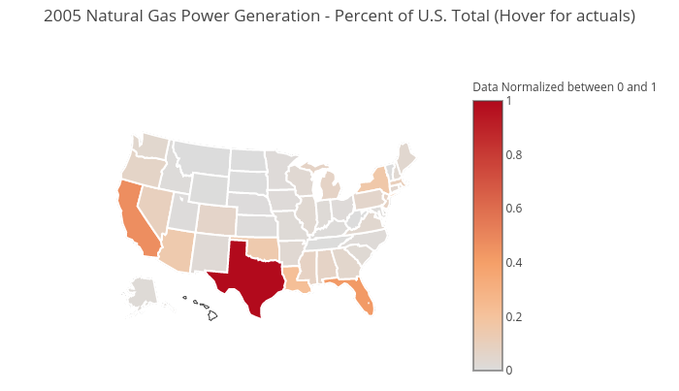
Natural Gas Power Generation vs CO2 Emissions Year 2005
Natural Gas Power Generation
CO2 Emissions
Click map to view actuals

Slide 12
Chronic Respiratory Disease Mortality Rate vs CO2 Emissions Year 2005
Chronic Respiratory Disease Mortality Rate
CO2 Emissions
Click map to view actuals

Slide 13
Chronic Respiratory Disease Mortality Rate vs Median Household Income Year 2005
Chronic Respiratory Disease Mortality Rate
Median Household Income
Click map to view actuals

Slide 14
Coal Power Generation vs Median Household Income Year 2005
Coal Power Generation
Median Household Income
Click map to view actuals

Slide 15
Natural Gas Power Generation vs Median Household Income Year 2005
Natural Gas Power Generation
Median Household Income
Click map to view actuals

Slide 16



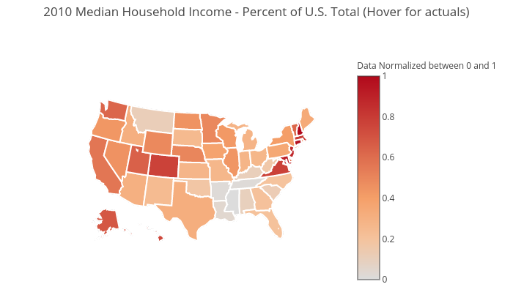
Click map to view actuals

Slide 17
Coal Power Generation vs CO2 Emissions Year 2010
Coal Power Generation
CO2 Emissions
Click map to view actuals

Slide 18
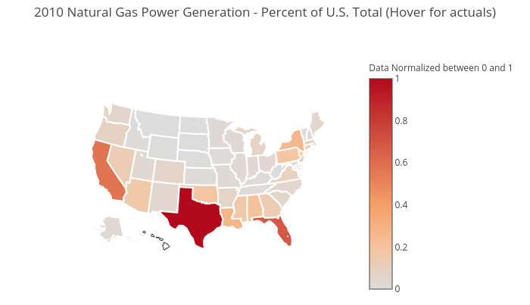
Natural Gas Power Generation vs CO2 Emissions Year 2010
Natural Gas Power Generation
CO2 Emissions
Click map to view actuals

Slide 19
Chronic Respiratory Disease Mortality Rate vs CO2 Emissions Year 2010
Chronic Respiratory Disease Mortality Rate
CO2 Emissions
Click map to view actuals

Slide 20
Chronic Respiratory Disease Mortality Rate vs Median Household Income Year 2010
Chronic Respiratory Disease Mortality Rate
Median Household Income
Click map to view actuals

Slide 21
Coal Power Generation vs Median Household Income Year 2010
Coal Power Generation
Median Household Income
Click map to view actuals

Slide 22
Natural Gas Power Generation vs Median Household Income Year 2010
Natural Gas Power Generation
Median Household Income
Click map to view actuals

Slide 23
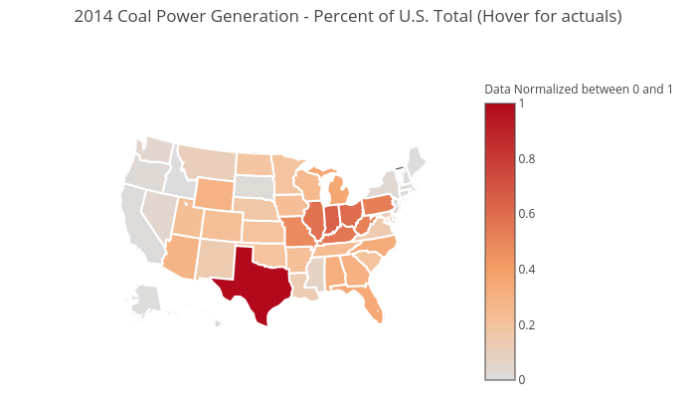

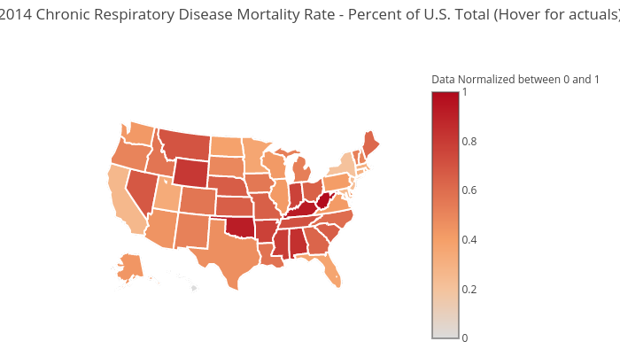
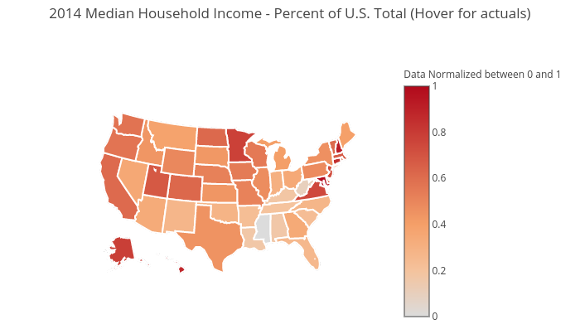
Click map to view actuals

Slide 24
Coal Power Generation vs CO2 Emissions Year 2014
Coal Power Generation
CO2 Emissions
Click map to view actuals

Slide 25
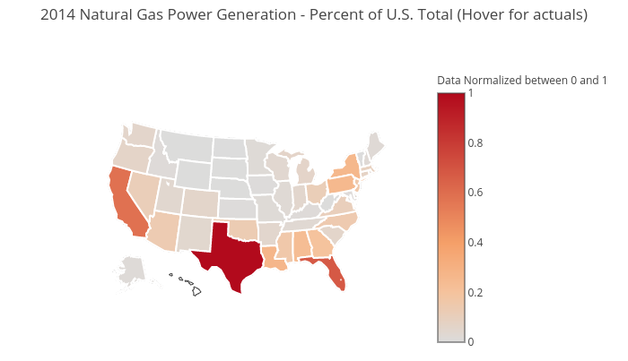
Natural Gas Power Generation vs CO2 Emissions Year 2014
Natural Gas Power Generation
CO2 Emissions
Click map to view actuals

Slide 26
Chronic Respiratory Disease Mortality Rate vs CO2 Emissions Year 2014
Chronic Respiratory Disease Mortality Rate
CO2 Emissions
Click map to view actuals

Slide 27
Chronic Respiratory Disease Mortality Rate vs Median Household Income Year 2014
Chronic Respiratory Disease Mortality Rate
Median Household Income
Click map to view actuals

Slide 28
Coal Power Generation vs Median Household Income Year 2014
Coal Power Generation
Median Household Income
Click map to view actuals

Slide 29
Natural Gas Power Generation vs Median Household Income Year 2014
Natural Gas Power Generation
Median Household Income
Click map to view actuals

